Slide 1
DoodleDebug
better than toString()

Slide 2
Architecture
Rendering pipeline:

Slide 3
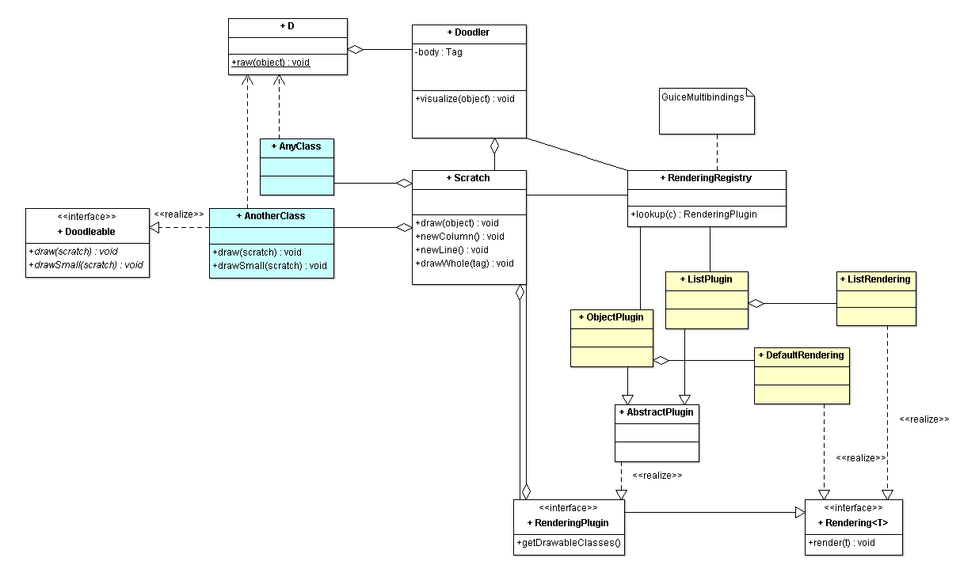

Slide 4
Design process
Analyzing usage of printOn: in SqueakSource:
590 of 2145 projects override printOn: methods
(2688 printOn: methods)
77 % percent include own class name!
ASCII-graphics are made (e.g. for matrices)

Slide 5
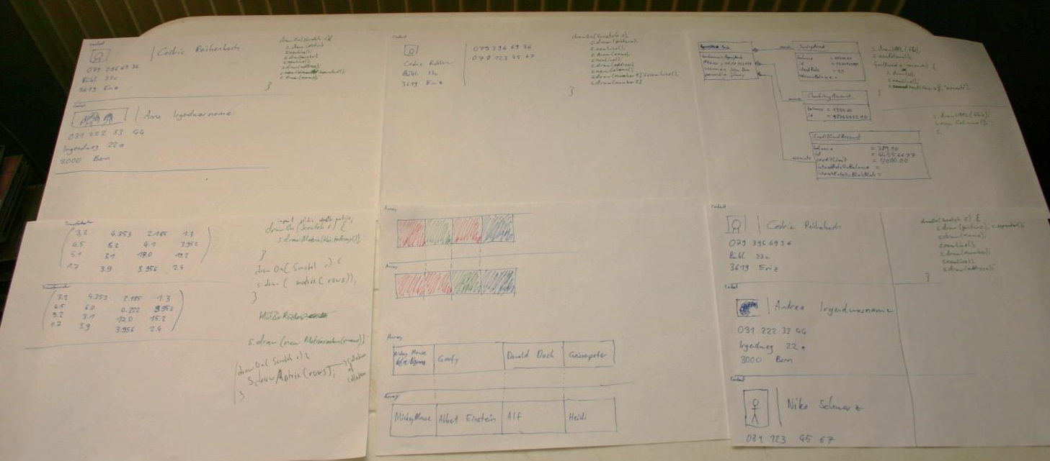
Design process
Sketching visualizations and
corresponding code snipplets

Slide 6
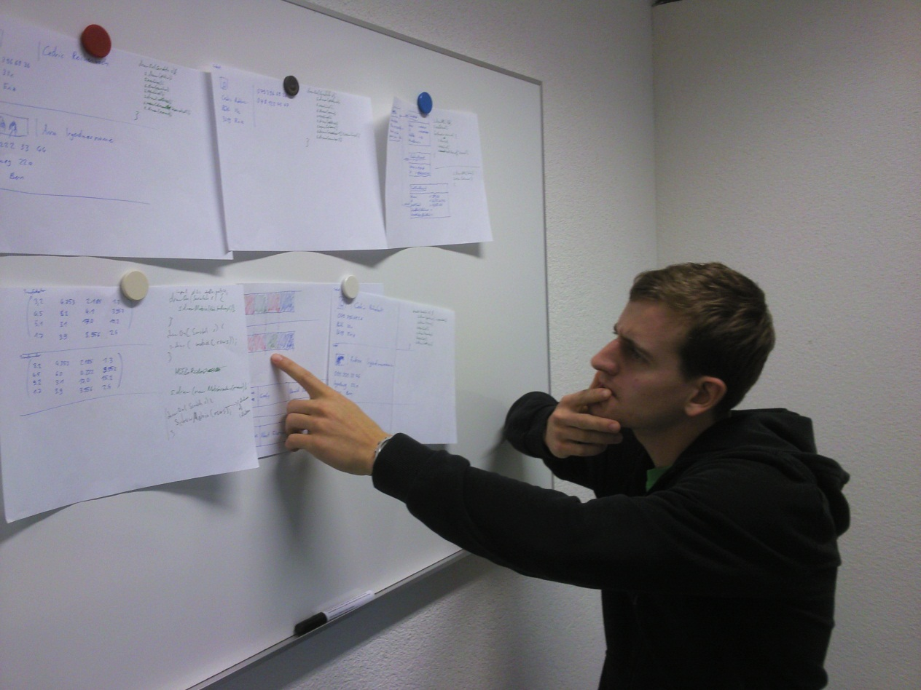
Design process
Talk to developers

Slide 7
Related work
Paper: «Let's go to the whiteboard: how and why software developers use drawings» by Cherubini, Venolia, DeLine, Ko main statement: Whiteboard → Computer Screen is too expensive

Slide 8
Related work
Paper: «Goal-directed zoom» by Woodruff, Landay, Stonebraker Semantic zoom: show desired information

Slide 9
Related work
Object inspectors like in Pharo similar to debuggers (one point in time)

Slide 10
Related work
Zest: An Eclipse Visualization Toolkit, not debug-oriented, not very simple

Slide 11
Related work
Hello World in Zest (without imports):
public class HelloWorld {
/**
* @param args
*/
public static void main(String[] args) {
Display d = new Display();
Shell shell = new Shell(d);
shell.setText("Hello, World");
shell.setLayout(new FillLayout());
shell.setSize(400, 400);
Graph g = new Graph(shell, SWT.NONE);
GraphNode hello = new GraphNode(g, SWT.NONE, "Hello");
GraphNode world = new GraphNode(g, SWT.NONE, "World");
new GraphConnection(g, SWT.NONE, hello, world);
g.setLayoutAlgorithm( new SpringLayoutAlgorithm(LayoutStyles.NO_LAYOUT_NODE_RESIZING), true);
shell.open();
while (!shell.isDisposed()) {
while (!d.readAndDispatch()) {
d.sleep();
}
}
}
}

Slide 12
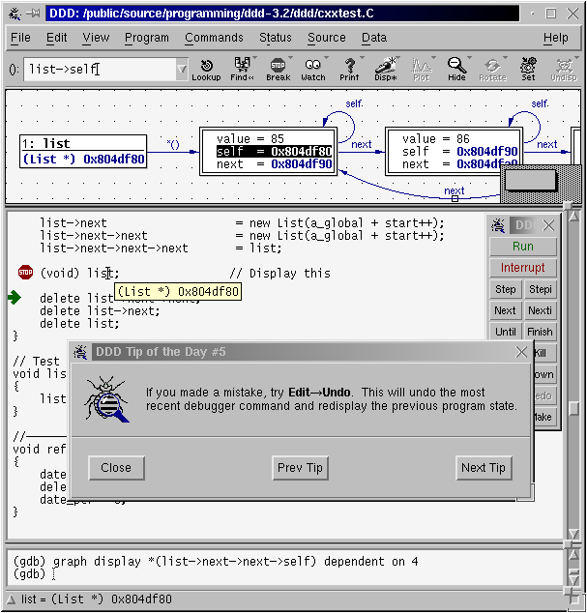
Related work
DataDisplayDebugger: Graphical front-end for existing command-line debuggers

Slide 13
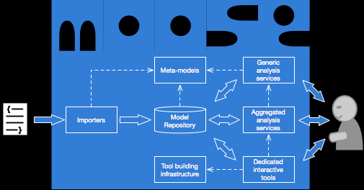
Related work
Moose

Slide 14
TODO:
More built-in renderings
Building Eclipse-Plugin
Use JavaScript to improve rendering (align corresponding components, semantic zooming)

Slide 15
Schedule
May 2012: Working Eclipse Plugin (& JavaScript)
July 2012: Paper finished
August 2012: Paper hand-in

